Slide 1

Boiler Feed Pump Efficiency Degradation Analysis
Capstone Project I
Author: Christopher T. Hui
Supervisor: Abhishek Goel
^{26th November, 2017}

Slide 2
The challenge focused on 3 key issues…
!
Demand for energy in Australia has not matched the growth in generation capacity resulting in oversupply, acting as a downward trigger for prices.
Lower energy prices for longer.
!
Continued maintenance overspend in a low margin environment hinders competitive capabilities.
Excessive maintenance of Boiler Feed Pumps reduces our revenue through increased expenditure; this has the potential to become a critical issue with material impact to overall gross profitability.
!
With increased competition and market share erosion, new technologies (i.e. analytics) is required to 1) remain competitive and 2) unlock insight through existing data assets.
Shifting market landscape has impacted fleet profitability requiring new approaches to drive costs.

Slide 3


..which were broken down into a series of requirements.
Client requirements
Our Approach
I need a real time view of our pump performance not an ad-hoc analysis. Our current view is redundant and excessively manual.
1
Clearly define the problem, developing a series of logical hypotheses that can be formulated and tested with commercial implications
Engineer
The efficiency equation is understood. However, the weightings of the variables are another story. Can you help?
2
Establish a clear hierarchical view of data assets required to undertake the analysis (i.e. Data Preparation)
Engineer
We track far too many tags for efficiency – any chance we can reduce the number of tags we are looking at?
3
Conduct deep analytics through statistical rigour and transform these into actionable insights
Engineer
4
How can we translate our static plant data into strategic insights our engineers can use?
Summarise insights into an solution to be presented to the client for approval / implementation
Management
Notes:
What does this look like now at a more granular level?

Slide 4
1
Clearly define the problem, developing a series of logical hypotheses that can be formulated and tested with commercial implications
Structuring our hypotheses…
1A.1. Reduce number of inspections and maintenance activities
1A.2. Reduce parts spend incl. lower cost of parts and better understanding of when a part fails to extend life
1A. Reduce cost of and time spent on maintenance activities
1A.3. Improve safety (incl. costs) by shifting from unplanned to planned maintenance
1A.4. Reduce costs by reducing overtime costs by better understanding of when issues occur
1A.5. Reduce contractor spend by better understanding of when issues occur
1B.1. Ensure maintenance activities are carried out at the right frequency
1. How can we increase availability of our fleet through maintenance for boiler feed pumps?
1B.2. Redefine operating procedures by learning from high-performance maintenance crews
1B. Increase boiler feed pumps’ efficiency by increasing the effectiveness of maintenance activities (i.e. efficiency monitoring)
1B.3. Benchmark pump performance over time to determine optimal operating curve
$x
1B.4. Identify efficiency from a stochastic perspective with associated variable weightings
$x
1B.5. Improve critical parts analysis to know where to focus effort to understand criticality
1C.1. Comparison to optimal performance: do maintenance when operating outside optimal operating regime.
1C. Increase efficiency of boiler feed pumps to avoid outages
1C.2. Benchmark performance across fleet to understand root causes for “underperforming” assets
Hypotheses to explore
Future Hypotheses to consider

Slide 5
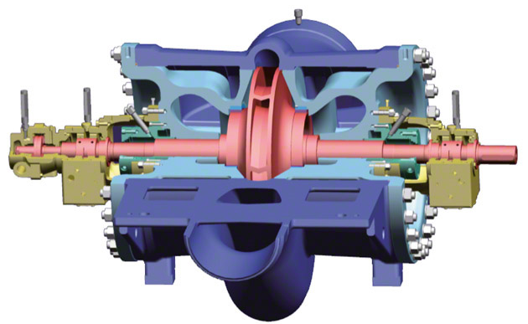
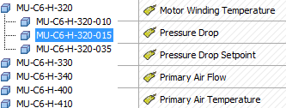



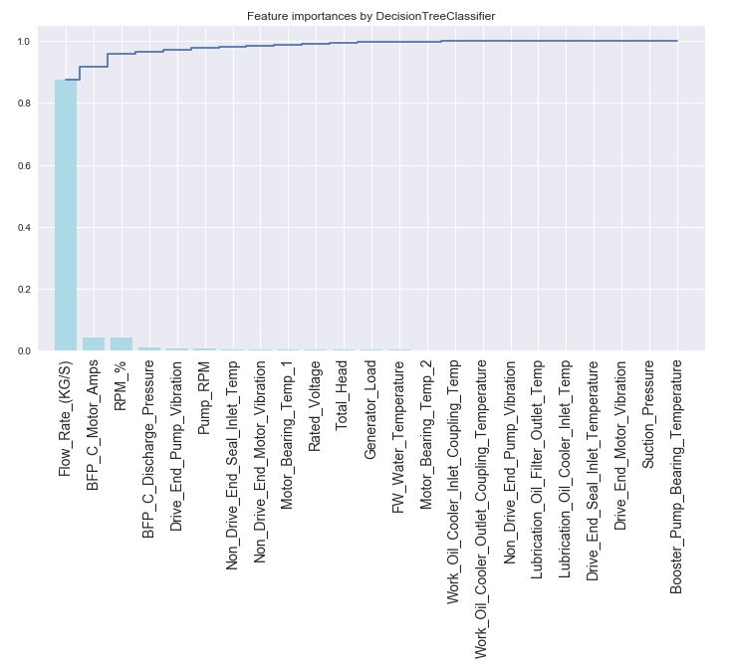



2
Establish a clear hierarchical view of data assets required to undertake the analysis (i.e. Data Preparation)
..through aggregation of our data assets, allow us to explore, …
Boiler Feed Pump
IoT Pump Sensor Tagging
OSIsoft PI Historian
PI Asset Framework Hierarchy (Consistent Tag Mapping – allows for reusable models)
SCADA
IT Comms
Microsoft Azure/Power BI
Future Production Model
SCADA
IT Comms
T3000 DCS
Python Bokeh (Visualisation)
Python Dataframe (Anaconda / Jupyter)
Ellipse Maintenance Database
SAP Maintenance Database
Scheduled Maintenance Activity based off ALCP
(ALCP data is a bit sketchy due to missing data)
Decision Tree Dimension Significance
Data Engineering / Wrangling

Slide 6
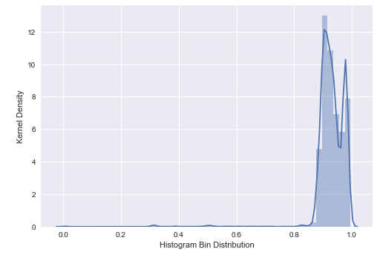
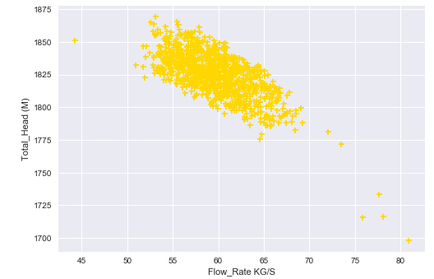
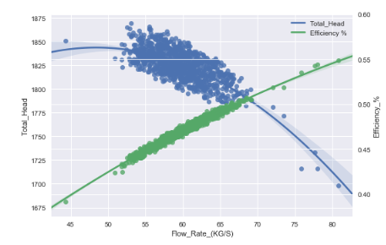
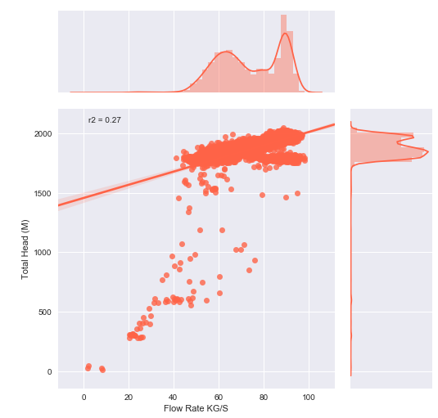
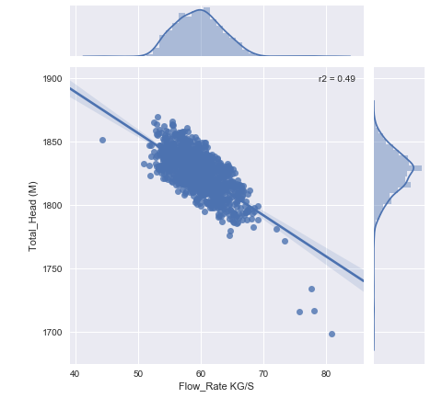
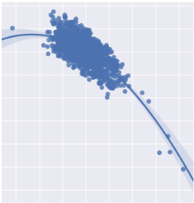
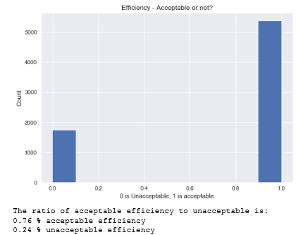
3
Conduct deep analytics through statistical rigour and transform these into actionable insights
..model and extract key insights…
1
We plot a Kernel Density Estimate to understand the distribution of our dataset.
3
From our KDE plot we are aware the distributions peaks at ~ 90%. Our data should be filtered to a more appropriate range.
5
Using this same logic, we have created an efficiency curve which highlights ‘optimal’ curves the Boiler Feed Pump to follow. However, as efficiency is a key metric – do we know what drives this?
2
Joint Regression Plot highlight a weak relationships between flow and head with a bimodal distribution becoming apparent. This shouldn’t be the case.
4
Fitting a 2nd order polynomial equation to the curve gives us an acceptable fit between Head and Flow Rate. Additionally our distribution has become that of a standard ‘Gaussian’ distribution.
6
Descriptive Stats + Exploratory Data Analysis

Slide 7
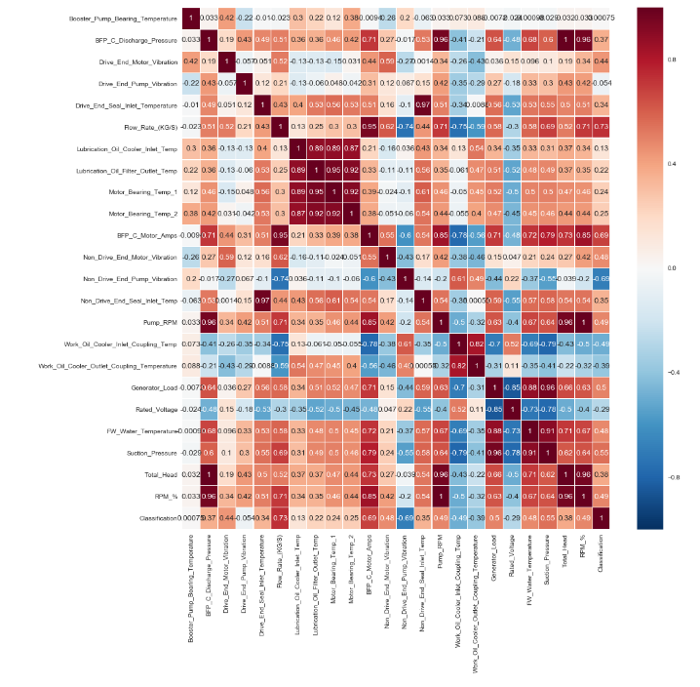
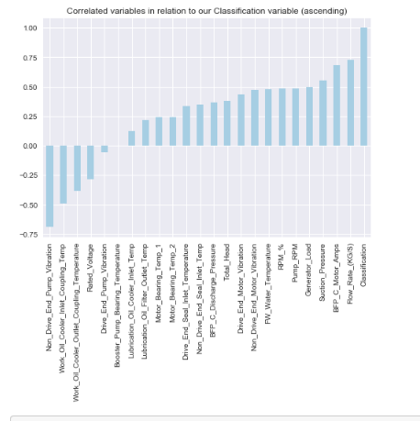
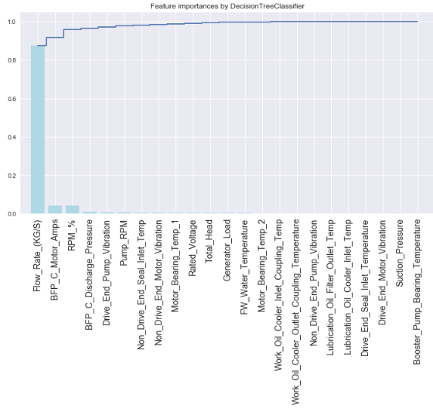
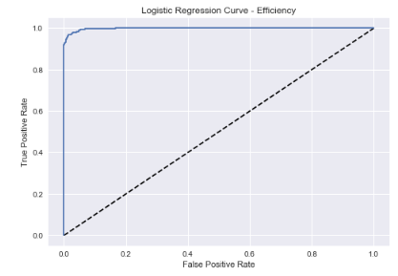
3
Conduct deep analytics through statistical rigour and transform these into actionable insights
..enabling value to be realised and addressed through data science…
7
Investigating efficiency further, a correlation cross plot has been formed to highlight the immediate relationships between our dependent variable, efficiency, and all other independent variables.
8
Isolating the correlated variables for efficiency enables us to have a first-pass review of whether the variables highlighted actually make sense in the context of pump efficiency. However, there are too many tags still. We need further dimensionality reduction.
9
Investigating efficiency further, we use a decision tree classifier with a 25 / 75 split. This dimensionality reduction highlights 3 features (tags) we should monitor on an ongoing basis rather than 40+. However, we need to validate this still.
1
0
Running a log-reg model alongside a 5-fold CV yields a promising fit with indication our choice of model may be a suitable fit for our data set.
Model Insight and Output

Slide 8
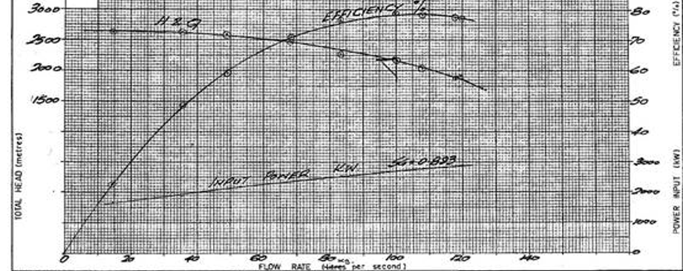
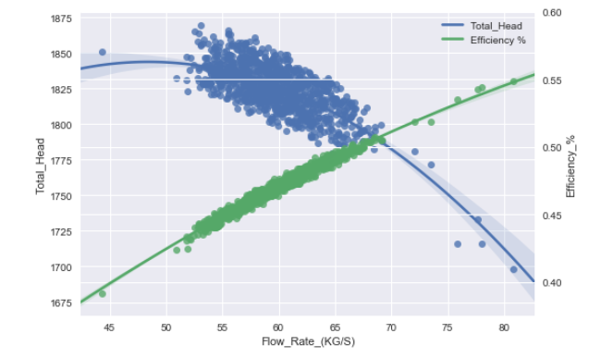
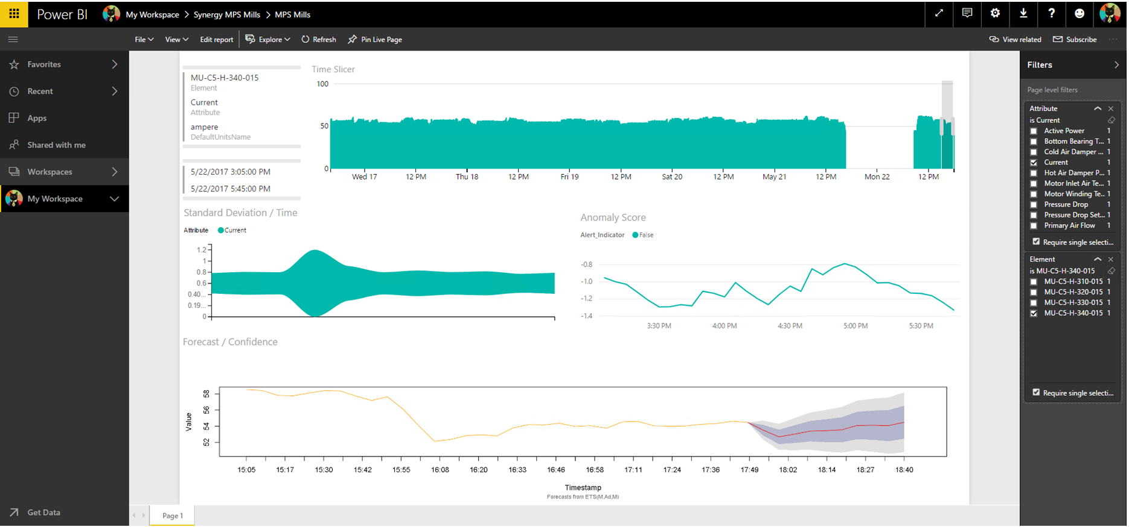
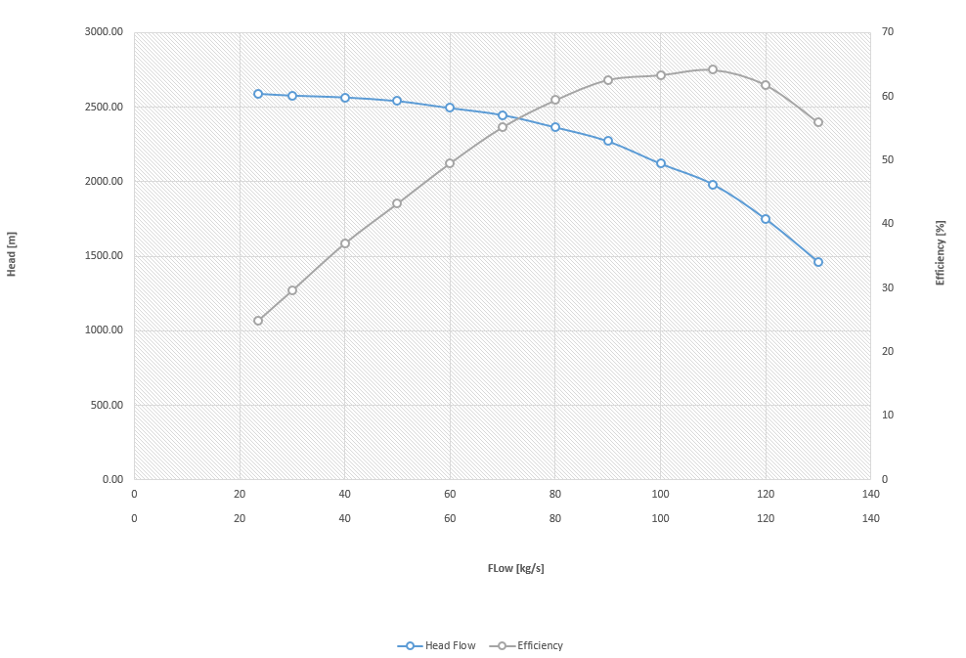
..allowing the engineers to monitor pump degradation via an optimal curve model trending against 3 PI tags on an ongoing basis.
Pump Performance Curve (1960 - 2017)
Pump Performance Curve (2017 Onwards)
Notes:
How do things look at the moment?

Slide 9
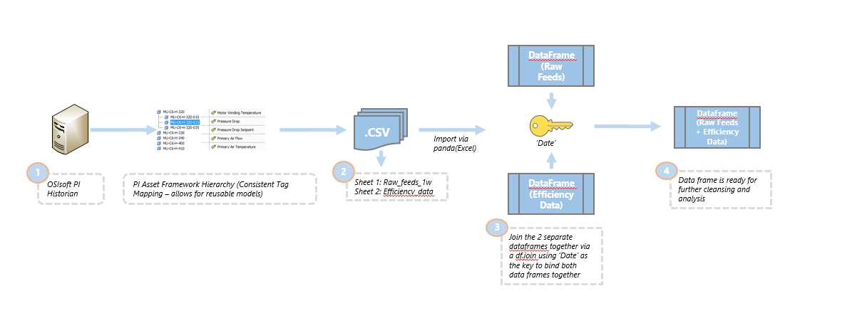
Appendix: Data Wrangling Methodology (Part I)
System Data Extraction - The first step we needed to do was take an extract from our OsiSoft PI System for the relevant tags related to Boiler Feed Pump Activity. This included things such as Vibration, Motor Temperature, Lubrication, Linear Displacement etc. These values were all taken on a specific 5 minute grain which was an linear interpolation of the sampled data over a 5 minute period.
CSVs – Once the data had been extracted, we placed the information in two ‘tables’. This is because certain information belongs in certain CSVs. While we did not stick to a predefined data model, we believe it is important to maintain separate tables for different types of data.
Joining the data – Using pd.read_csv and storing the csv into a dataframe is the first step. The second step was to join these two different data frames using the ‘join’ command which linked the two data frames together by a common index – in our case this is the date.
Review the data – Inspecting the data revealed that we had almost everything we needed for our Boiler Feed Pump Calculation with the exception of Total Head (Refer to the next slide)

Slide 10
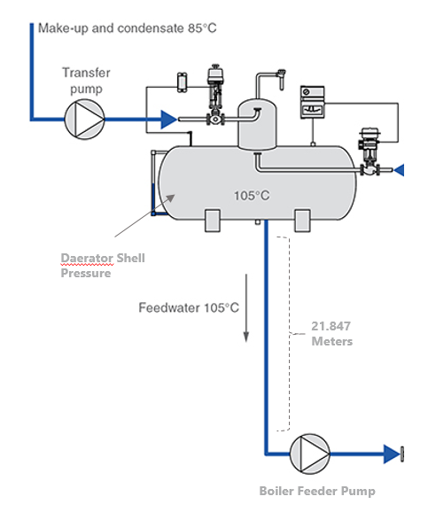

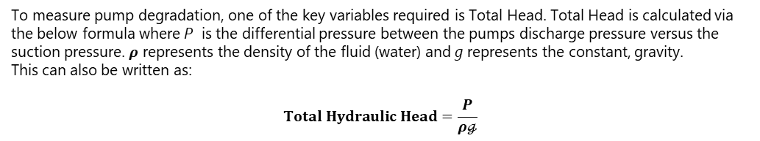
Appendix: Data Wrangling Methodology (Part II)
To measure pump degradation, one of the key variables required is Total Head. Total Head is calculated via the below formula where P is the differential pressure between the pumps discharge pressure versus the suction pressure. $ρ$ represents the density of the fluid (water) and g represents the constant, gravity. This can also be written as:
$$Total Hydraulic Head=\frac{P}{ρℊ}$$
Like most data science projects, we had missing data. However this could not be imputed with regular panda means such as ffill or bfill. In this case, apart from traditional data cleansing (NA’s, values > 0 etc.) we also had to contend with the missing suction pressure. If we miss the suction pressure, we cannot calculate the rate of change in P ; Hence we would not be able to calculate Total Head.
While we did not have Suction Pressure, we noted that for every Boiler Feed Pump it is connected to the deaerator. The deaerator is a part of plant which strips oxygen from fluids (it de-aerates them). We have a sensor here with recordable deaerator pressure. Further analysis from engineering drawings yields the distance from the deaerator through to the Boiler Feed Pump - 21.847 Meters.
With this information, we can convert the height using the Standard Instrumentation metrics converting Meters to an appropriate kPa metric. (1 kPa = 0.1019977 Meters).
Combining this with the deaerator pressure sensor enables us to recreate the suction pressure value as shown below.
Additionally, to ensure the values we had were in an acceptable range we included the following filter.
If the filter is to be defined as ‘on’ then:
Flow rate must be greater than 0
Pump RPM must be greater than 0
Total Head > 0

